Slide 1
Sprocket Central Pty Ltd
Analytical Presentation

Slide 2
Agenda
Introduction
Data Exploration
Model Development
Interpretation

Slide 3
Introduction
This document will explore the following parts of the document:
Age distribution
Number of bikes purchased in last 3 Years
Attributes of high valued customers like: Wealth segments, State of residency, Car ownership by state, Job category

Slide 4
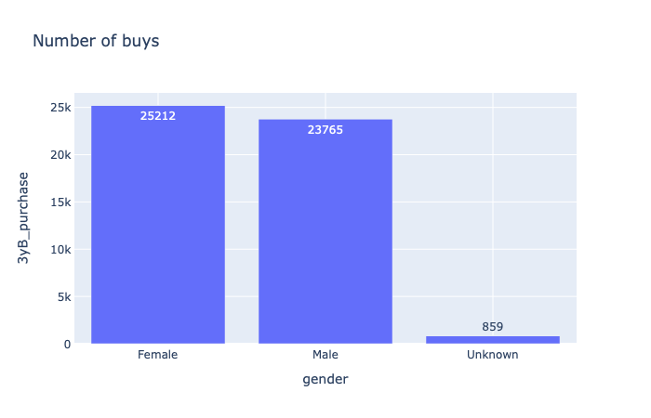
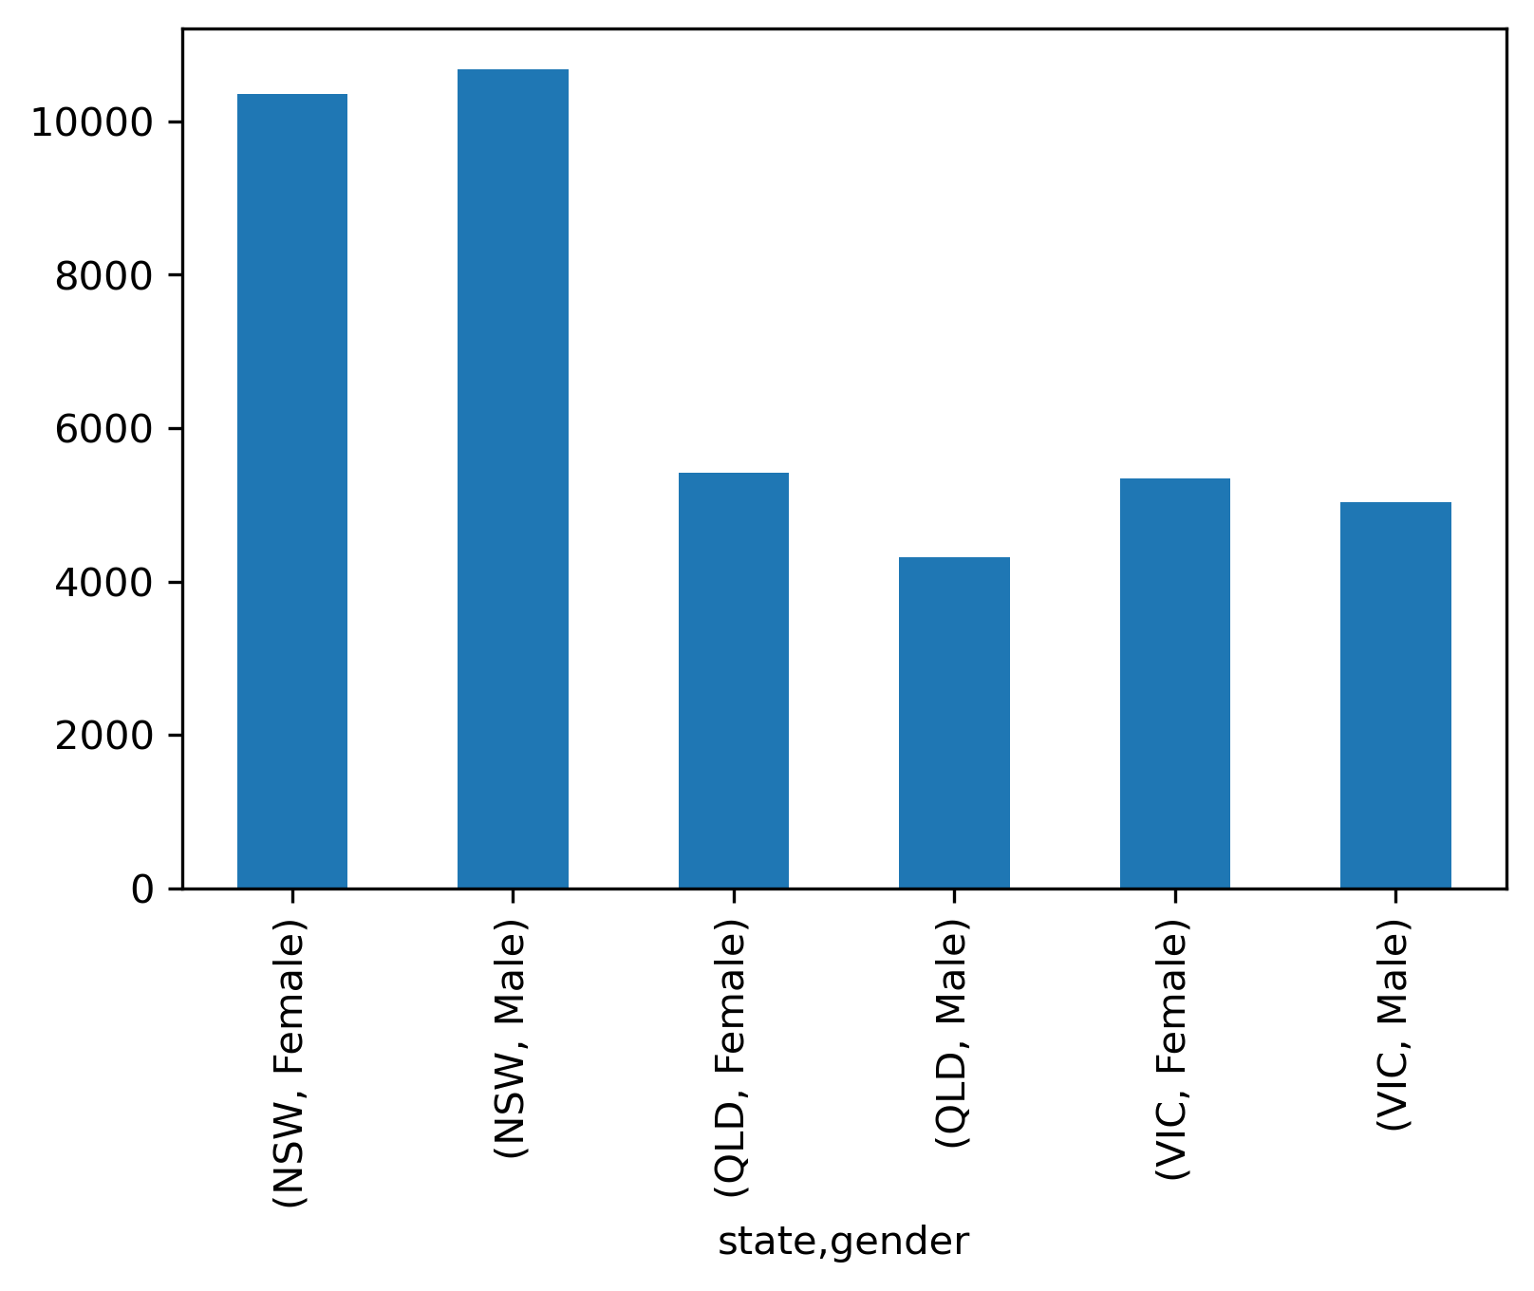
Data Exploration & Model Development
General dataset total bike purchase
Data shows bikes purchased across three states;
Females 25212, Males bought 23765 bikes while 859 by
Unknown gender.
By state purchase
We can see that the by state, NSW bought more bikes , followed
by VIC.
> > So since most of our customers come from NSW, we will focus on NSW and
Understand the market and also draft our focus customers.

Slide 5
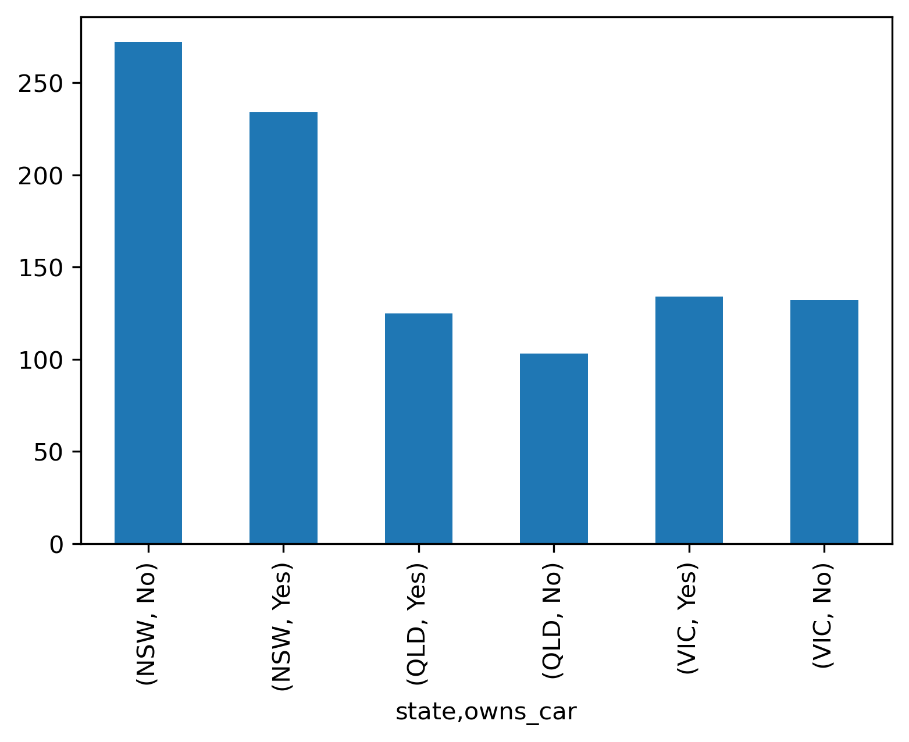
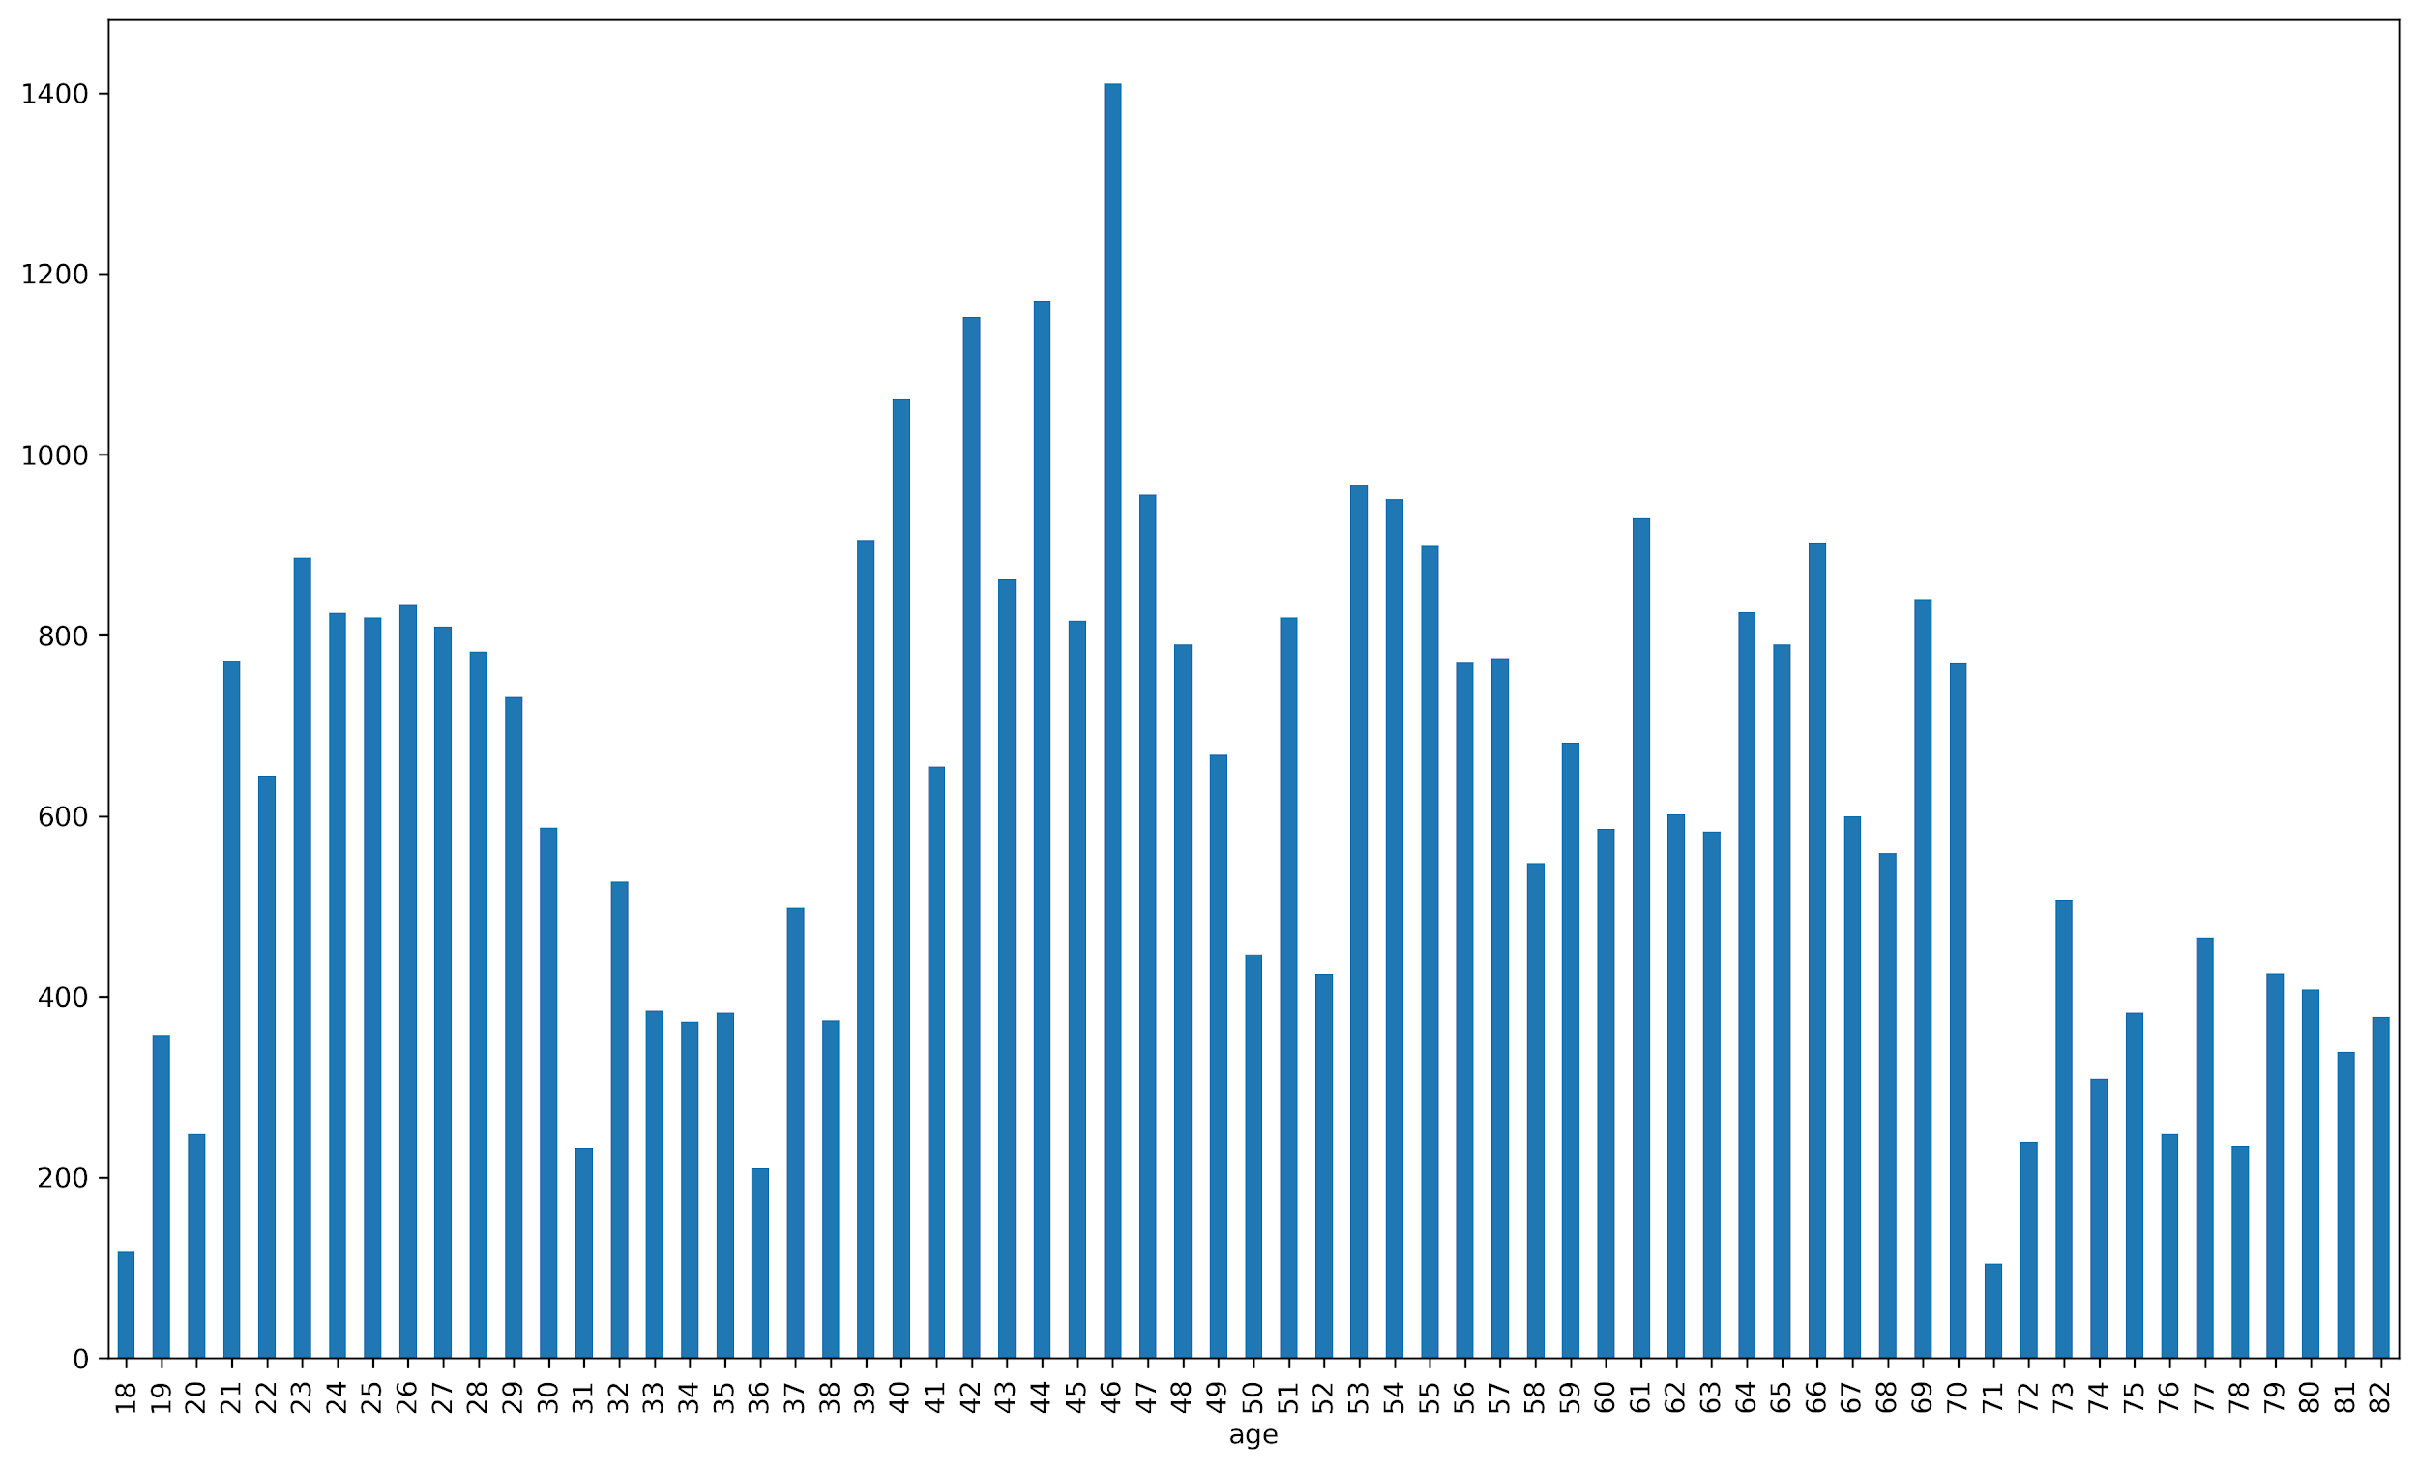
Data Exploration & Model Development
Car owned in State
NSW is a good focus because the city shows that many of its residents
use public transport, and this one of the reasons they got more bikes
as compared to other cities.
Age Distribution
General dataset shows that our customers range from
age 18 to 82. Also from the dataset we see that age
bracket with the most purchase are between age 40 - 46.
Also we see that age 46 shows the most purchase compared to the other
age brackets.

Slide 6
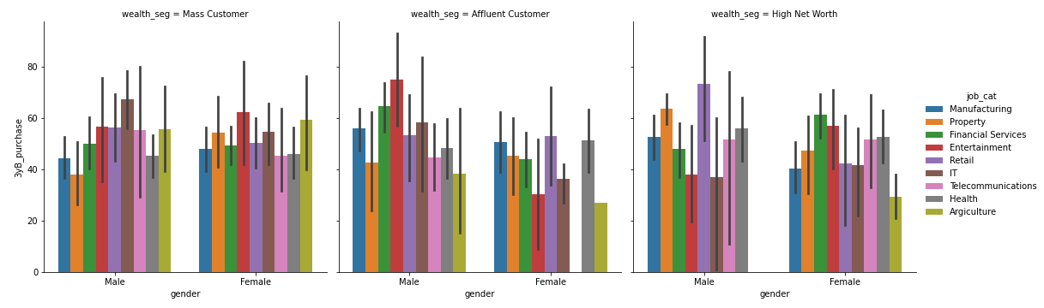
Data Exploration & Model Development
From the dataset, we see the job categories, wealth segments of our customers. We see that the most purchase are from males from the Entertainment, IT and Retail industry, under the Affluent Customer, Mass Customers and High net worth wealth segments.

Slide 7
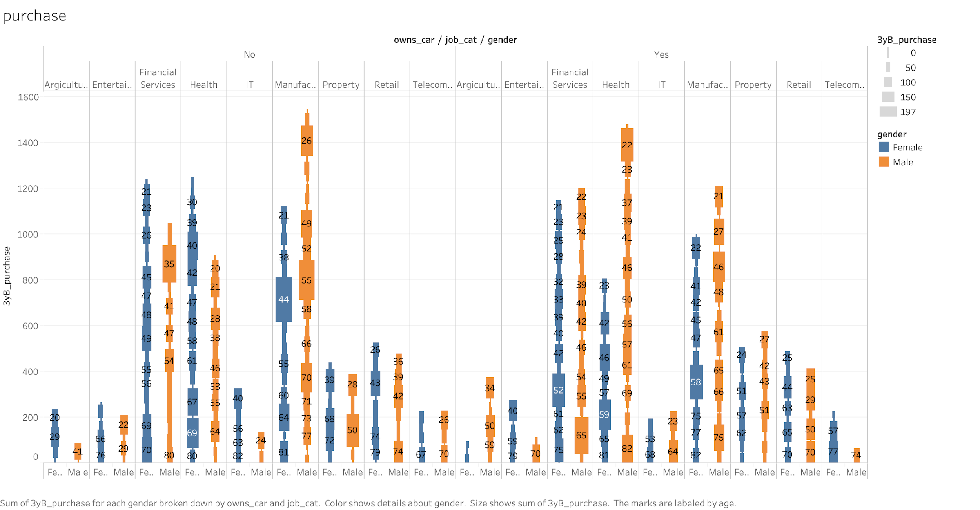
Model Interpretation
From the dataset, we see that our customers
with no vehicle bought most bikes, and they fall under the Manufacturing industry.
Another segments are the customers from the health sector and financial industry.
Notes:
From the dataset, we see the job categories, wealth segments of our customers. We see that the most purchase are from males from the Entertainment, IT and Retail industry, under the Affluent Customer, Mass Customers and High net worth wealth segments.
Based on the data set presented here, it has been concluded that the highest customer category ranges from age 44 to 55. As a result, this customer segment should be the target group when promoting the product.

Slide 8
Interpretation
Based on the dataset, we can draw to conclusion that;
NSW residents bought more bikes
NSW residents mostly use public transport (owned no cars), when compared with other states
Males from the NSW state bought more bikes when compared to the females
Customers from manufacturing industry of age 44 - 55, showed high purchase of bikes. These customers owned no cars and fall under Mass customer & Affluent wealth segment.
Customers from the financial service of age 36 - 65 also bought more bikes when compared with other wealth segments, falling under the wealth segment high network

